Slide 1
Coursera Capstone Project
The Battle of Neighborhoods

Slide 2
A map of Boston

Slide 3

The problem and a discussion of the background
Data Source:
https://geodata.lib.berkeley.edu/catalog/MEATOUR95PT

Slide 4
Data Includes:
Museum locations
Attractions
Shows the Longitude and latitude of each museum and the geometry
Addresses of museums
Analysis the difference in names in each portal name
The city of each museum
postal code of each tourist attraction

Slide 5
The problem we have to solve
Finding the closest nearby museum and tourist attraction close to the main city of Boston
Finding names of main Museums in Massachusetts

Slide 6
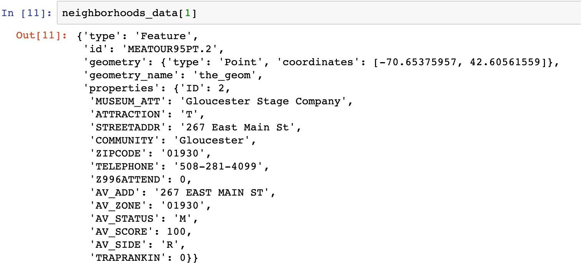
Eg. Neighborhoods column json data

Slide 7
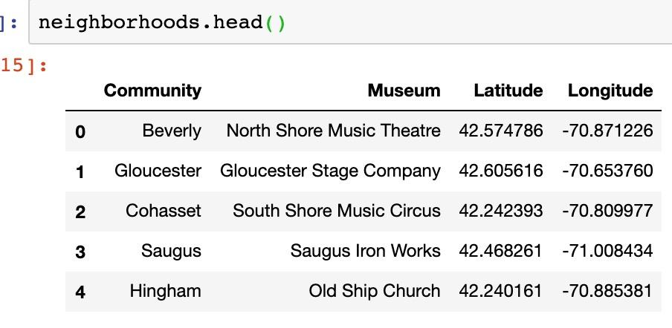
Neighborhoods head data

Slide 8
How Many communities and Museums we have in Massachusetts
The geographical coordinates of this community address 267 East Main St,01930

Slide 9
A map of the museums in Massachusetts

Slide 10
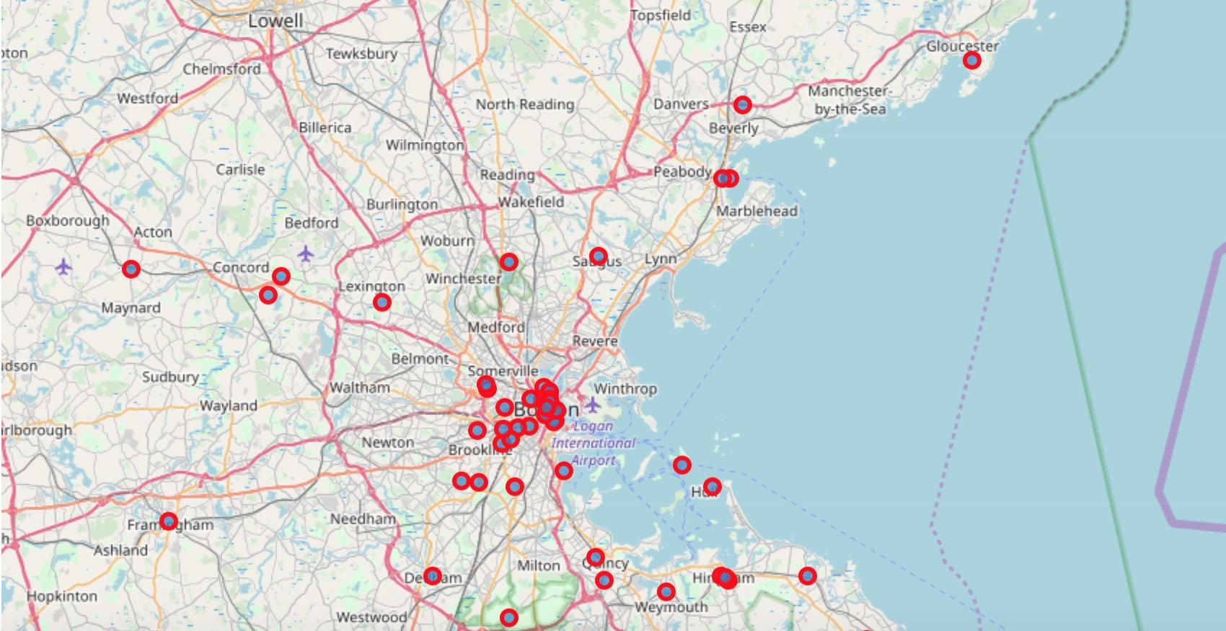

Slide 11
